Slide 1

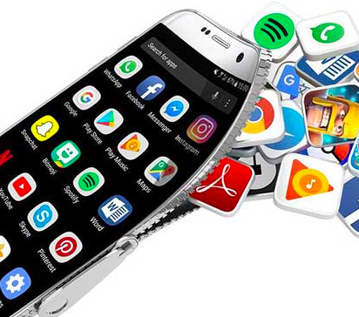
App Trader
Team Ghidorah
February 16, 2021

Slide 2
Business Model
App Trader pays $10,000 per store or 10,000 times the price of the app - whichever is greater
Apps earn $5000/month per store. Half of this amount goes to the developer, meaning App Trader earns $2500/month per store
App Trader spends $1000/month to market an app. This amount is NOT doubled per store
Star rating is equivalent to App longevity

Slide 3
What is the ideal app?
Free
Upfront cost is lower, no difference in monthly income vs paid apps
Available in both App and Play stores
Doubles monthly profits without increasing marketing spend
5 Star
These apps will be around longer and generate more profit
Notes:
5 star app around an average of 11 yrs vs a 1 star app only around for 3. the longer an app is around the less upfront costs AT is going to have over time

Slide 4
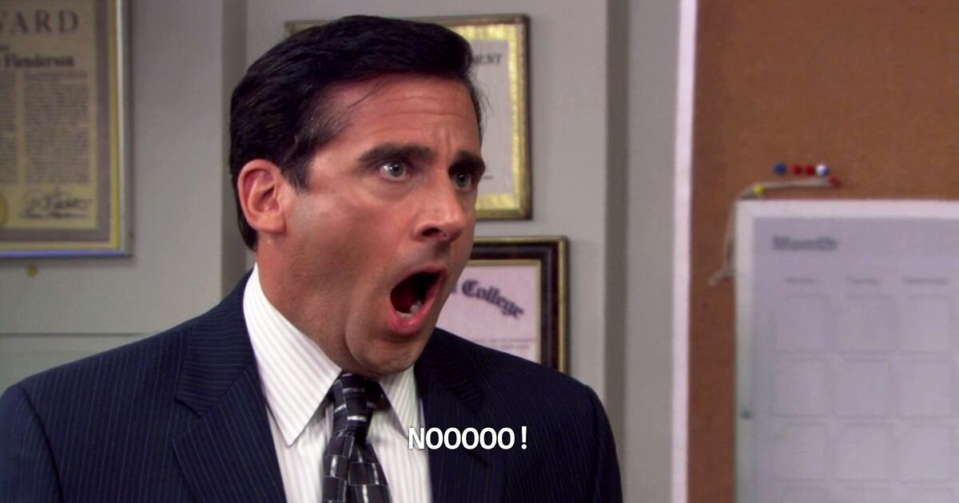
Does this app exist?
Notes:
We have to adjust our parameters a little bit

Slide 5
How close to ideal can we get?
Adjust to 4.5 star rating and above
Filtering further
72 apps on both stores are rated 4.5 stars and above while also being free
Keeps apps with highest longevity
Focus on highest rated
Then most popular genre
Then largest content rating category

Slide 6
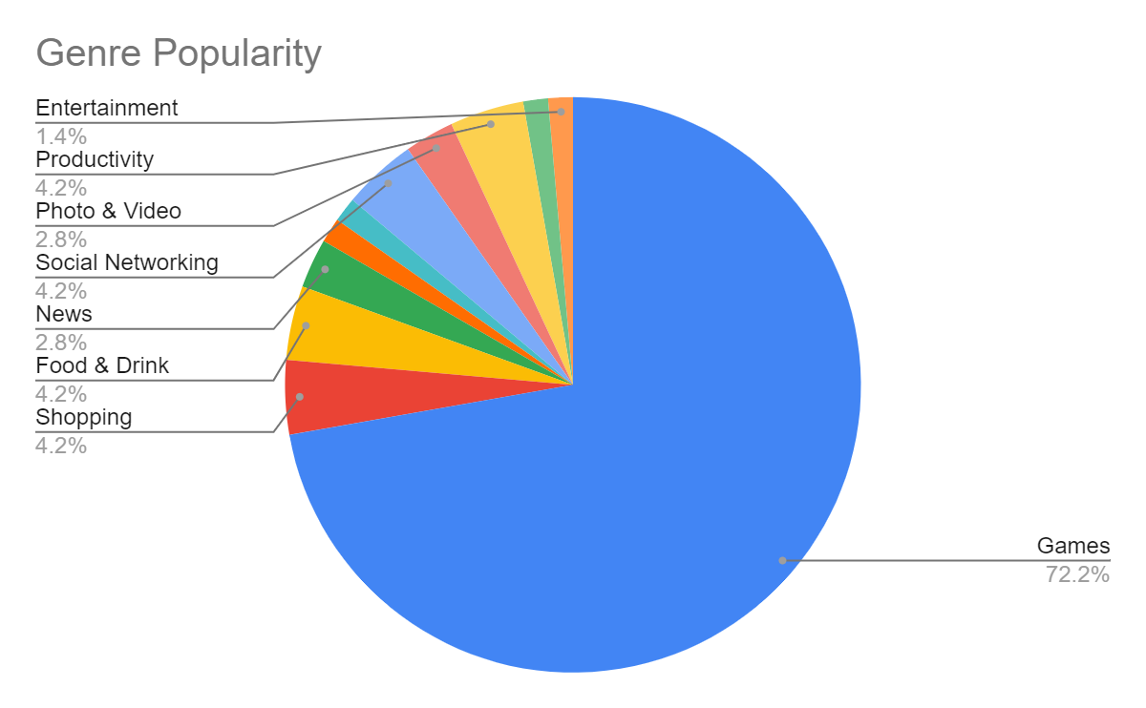
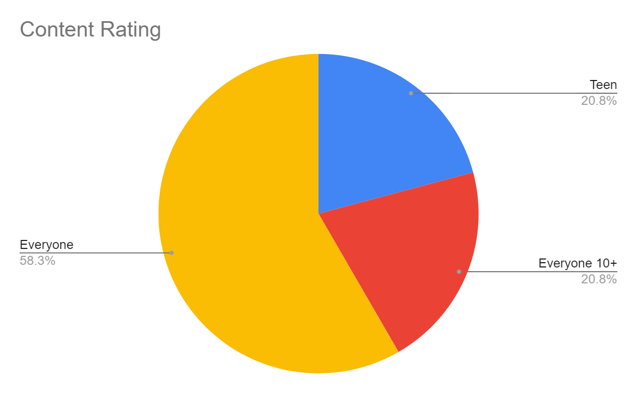
Most Popular Genre and Content Rating
Notes:
In our genre popularity chart games comes away as the clear winner
Content rating is skewed heavily toward apps rated for everyone, especially once everyone 10 and up is included

Slide 7







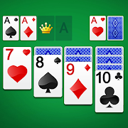


Our Recommendations
ASOS
Domino’s Pizza USA
PewDiePie's Tuber Simulator
Egg, Inc.
The Guardian
Geometry Dash Lite
Fernanfloo
Bible
Solitaire
Toy Blast
Notes:
These are the apps that best fit our criteria
ASOS, Dom, Pew, Egg, Guard, Geo all are rated 5 stars in App store, with higher than 4.5 in Play store
The next highest rated apps were Fernafloo and Bible
Solitaire and Toy Blast were the highest rated when looking at the genre Games and the Content Rating Everyone

Slide 8
Any Questions?

Slide 9
Thank You!
Rob Kirkpatrick
Celine D’Amore
George Mills
Elizabeth Houghton

